Slide 1
Should an Athlete Turn Pro “Early”?
Chapter 24

Slide 2
Lesson: Should an Athlete Turn Pro Early?
Objectives:
Examine the decision calculus that an thlete should follow to reach an optimal decision ex ante
Explain the costs and benefts of postponing a professional career
Examine some constraints imposed by sports leagues and organizations on “underage” athletes

Slide 3
To Stay or Not To Stay?
An athlete must conduct a cost-benefit analysis: expected benefits of leaving school and turning pro minus expected costs of not staying at school.
If expected benefits > expected costs: athlete should turn pro early
It is not easy to quantify some costs and benefits. Examples?
Example: Chris Brown (U of Colorado) decided to head for the NFL instead of returning to school his senior year.
Cost of postponing the dream
Uncertainty: most people are risk averse

Slide 4
Potential Costs of Leaving School
Athletic Development
Educational Development
Physical and Emotional Maturity
Enjoying College Life

Slide 5
Potential Benefits of Leaving School
Professional Earnings
Cost of an Injury
Changed Market Conditions
Poor Team Performance
Risk of Reduced Performance

Slide 6
Early Entrants and the NFL
All NCAA players with remaining eligibility can get advice from the NFL regarding their draft status
In 2006, 15 of 49 players went undrafted.
The undrafted players can sign free-agent contracts with any interested team.
BUT
The undrafted players cannot return to college football.
Summary: The exceptional players who are drafted early may have made a wise choice. For the rest staying in school would have been a better choice.
Round | 2006 | 2008 | 2010
1 | 12 | 11 | 17
2 | 8 | 11 | 8
3 | 4 | 9 | 7
4 | 5 | 3 | 6
5 | 1 | 2 | 3
6 | 1 | 1 | 5
7 | 3 | 2 | 0
Undrafted Total | 15 49 | 14 53 | 7 53

Slide 7
A Simple Economic Model
Let’s look at the effect of lifetime earnings of turning pro at various points in time
Start when the athlete graduates from high school. Assume the athlete will have a professional career of T years (whether or not they turn pro)
Remaining in school and preparing for the pro career cause earnings to grow at rate r, but that growth declines over time:
r1 > r2 > r3 > r4
(rate in year 1 > rate in year 2 > rate in year 3 > rate in year 4)

Slide 8
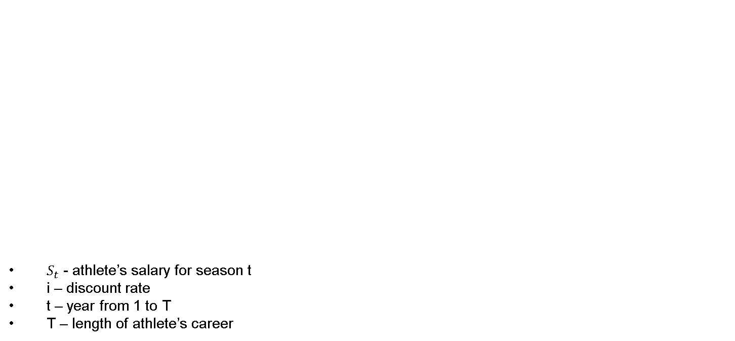
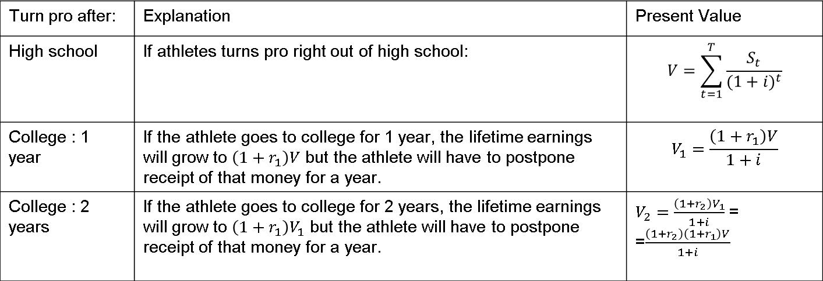
A Simple Economic Model
$S_{t}$ - athlete’s salary for season t
i – discount rate
t – year from 1 to T
T – length of athlete’s career
Turn pro after: | Explanation | Present Value
High school | If athletes turns pro right out of high school: | $$V=\sum_{t=1}^{T}{\frac{S_{t}}{{(1+i)}^{t}}}$$
College : 1 year | If the athlete goes to college for 1 year, the lifetime earnings will grow to $\left(1+r_{1}\right)V$ but the athlete will have to postpone receipt of that money for a year. | $$V_{1}=\frac{\left(1+r_{1}\right)V}{1+i}$$
College : 2 years | If the athlete goes to college for 2 years, the lifetime earnings will grow to $\left(1+r_{1}\right)V_{1}$ but the athlete will have to postpone receipt of that money for a year. | $V_{2}=\frac{\left(1+r_{2}\right)V_{1}}{1+i}$ = =$\frac{\left(1+r_{2}\right)\left(1+r_{1}\right)V}{1+i}$

Slide 9
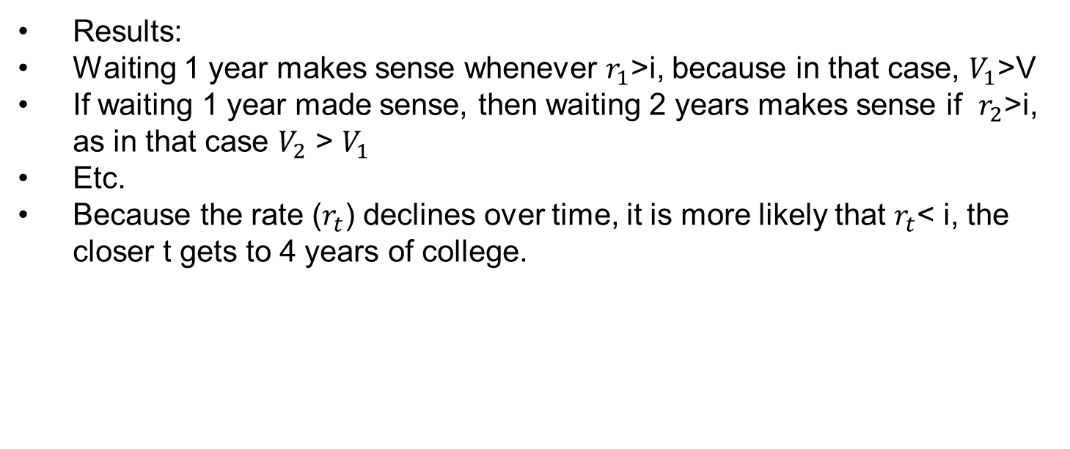
A Simple Economic Model
Results:
Waiting 1 year makes sense whenever $r_{1}$>i, because in that case, $V_{1}$>V
If waiting 1 year made sense, then waiting 2 years makes sense if $r_{2}$>i, as in that case $V_{2}$ > $V_{1}$
Etc.
Because the rate ($r_{t}$) declines over time, it is more likely that $r_{t}$< i, the closer t gets to 4 years of college.

Slide 10
Decision Rule
Given this simple economic model, decisions are straightforward:
If r > i, delay (stay in school),
If r < i, turn pro
What influences the value of r?
Experience, maturity, injury, competition from rivals, team quality, coaching quality etc. This value varies across players.
Is r necessarily positive?
No, r can be negative.
Example: Jeff Morrison (Florida, tennis player) – won the NCAA singles title as a sophomore. At that time, he got many lucrative opportunities to turn pro. He stayed for the third year, and did not defend his NCAA singles title – opportunities to turn pro disappeared. His r3 was clearly negative (negative growth)

Slide 11
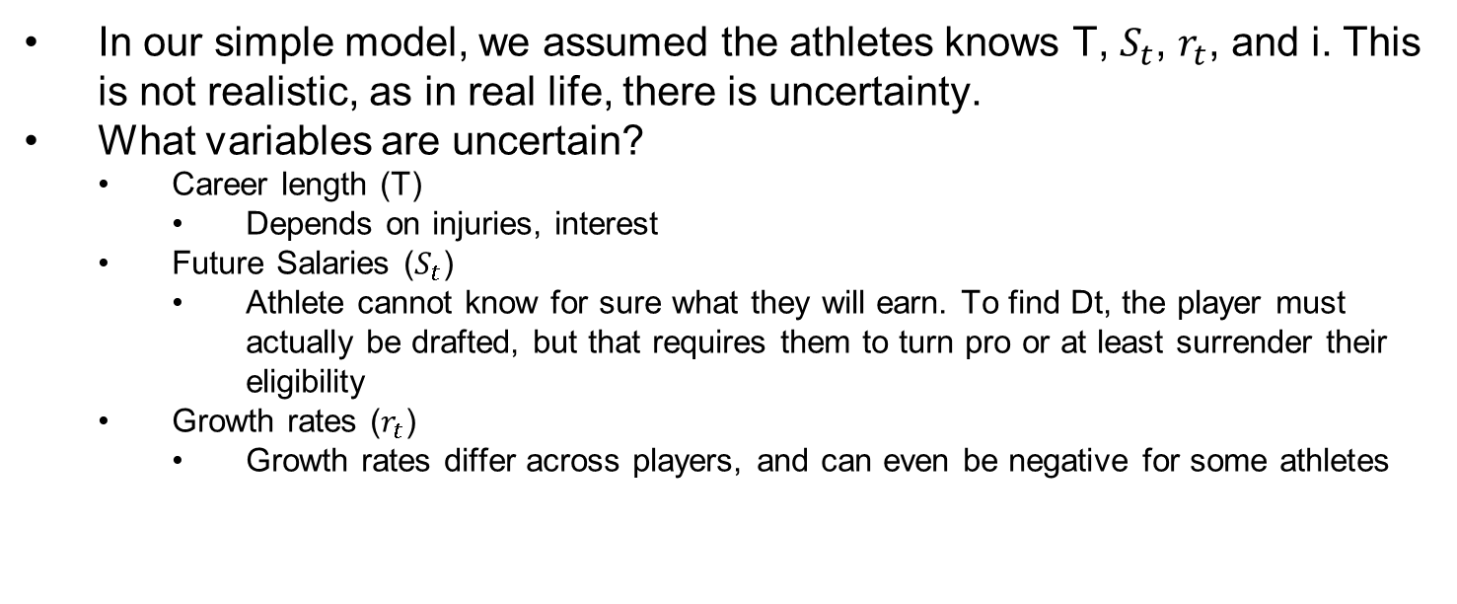
Uncertainty
In our simple model, we assumed the athletes knows T, $S_{t}$, $r_{t}$, and i. This is not realistic, as in real life, there is uncertainty.
What variables are uncertain?
Career length (T)
Depends on injuries, interest
Future Salaries ($S_{t}$)
Athlete cannot know for sure what they will earn. To find Dt, the player must actually be drafted, but that requires them to turn pro or at least surrender their eligibility
Growth rates ($r_{t}$)
Growth rates differ across players, and can even be negative for some athletes

Slide 12
Age Limits in Pro Sports
Exist in each professional sports league and organization
Reasons for age limits:
To protect young athletes from injury, “burnout”, stress of professional competition
To protect incumbent participants from competition by newcomers
NCAA is a free minor league / training ground for NFL
To reduce risk for the major league, like NFL: Athlete’s potential becomes easier to assess

Slide 13
Age Limits in Pro Sports
Table 24.3 Age Limits on Eligibility. Source: Blair, Sports Economics
League / Organization | Minimum Age
National Football League | 20-21
Major League Baseball | 18
National Basketball Association | 19
National Hockey League | 18
Professional Golf Association Tour | 18
Ladies Professional Golf Association | 18
Association of Tennis Professionals | 14
Women’s Tennis Association | 14
Soccer | None
USA Track and Field | 19
NFL: an athlete must be 3 years removed from high school
NBA: Players used to be eligible right after high school. Now: player must be 19 and at least 1 year removed from high school.
MLB: player must be 21, or have graduated high school & not yet attended college, or a college player after junior year
WTA & ATP: restrictions for players from 14 to 18
Track and Field: athletes are classified based on age

Slide 14
Leaving High School Early
1995: Kevin Garnett went from high school ball to NBA
1996: Kobe Bryant
2001 draft: Kwame Brown was #1 pick
Other top picks out of high school: LeBron James (2003), Dwight Howard (2004)
Jeremy Tyler: skipped senior year in high school, and signed with Haifa in Israel. Had problems with being on time, was arrogant, poor work habits. Quit and returned home.
2006: NBA required players to be 19
Some players followed: Greg Ogden, O.J. Mayo
Others went to Europe: Brandon Jennings

